Slide 1
Machine Learning Part II Neural Network ML Diagnostic

Slide 2
Motivation
When we have to many features, and we need a non-linear hypothesis, the linear(polynomial) regression and logistic regression is not a good algorithm.

Slide 3
Model Representation
The function maps inputs to output is called activation function.
- also uses sigmoid function
The parameters are also called weights.
Input layer, hidden layers, output layer

Slide 4
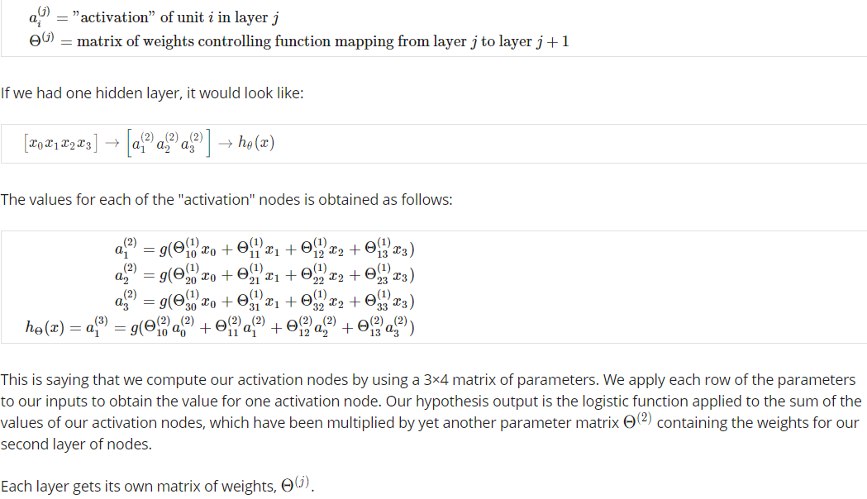

Slide 5
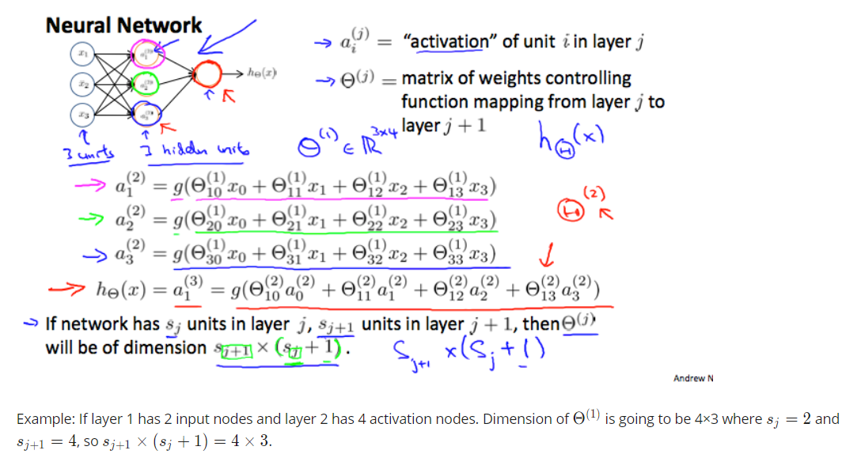

Slide 6
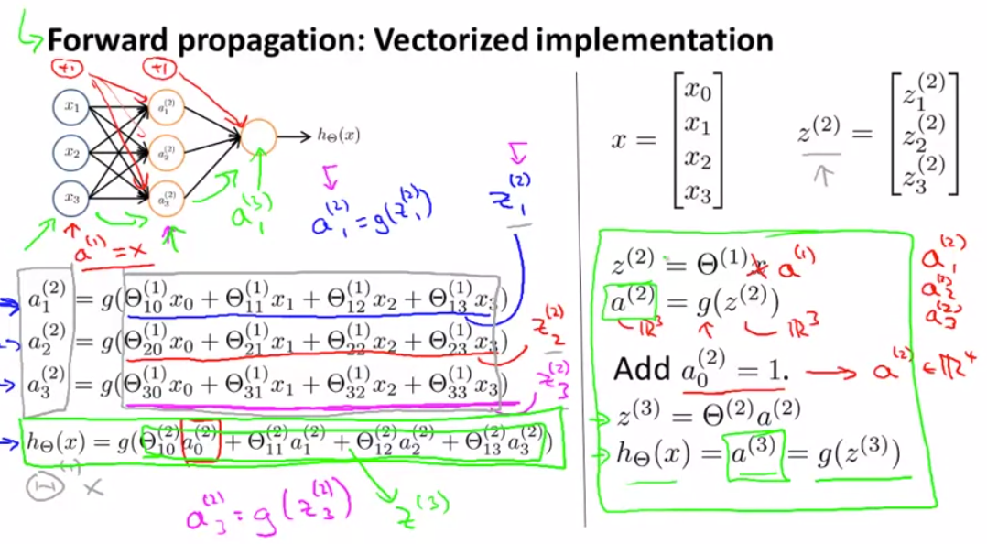

Slide 7
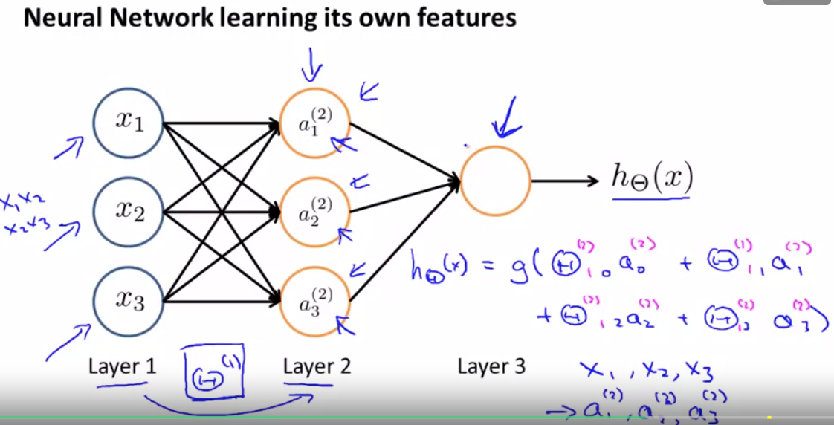
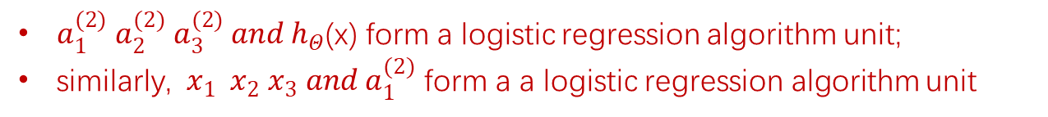
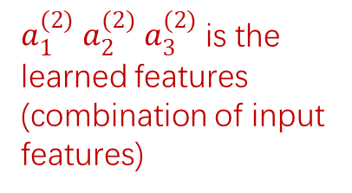
Neural Networks is actually a multi-units multi-layer logistic regression algorithm
$a_{1}^{(2)}$ $a_{2}^{(2)}$ $a_{3}^{(2)}$ is the learned features (combination of input features)
$a_{1}^{(2)}$ $a_{2}^{(2)}$ $a_{3}^{(2)} and h_{Θ}$(x) form a logistic regression algorithm unit;
similarly, $x_{1}{ x}_{2}$ $x_{3} and a_{1}^{(2)}$ form a a logistic regression algorithm unit

Slide 8
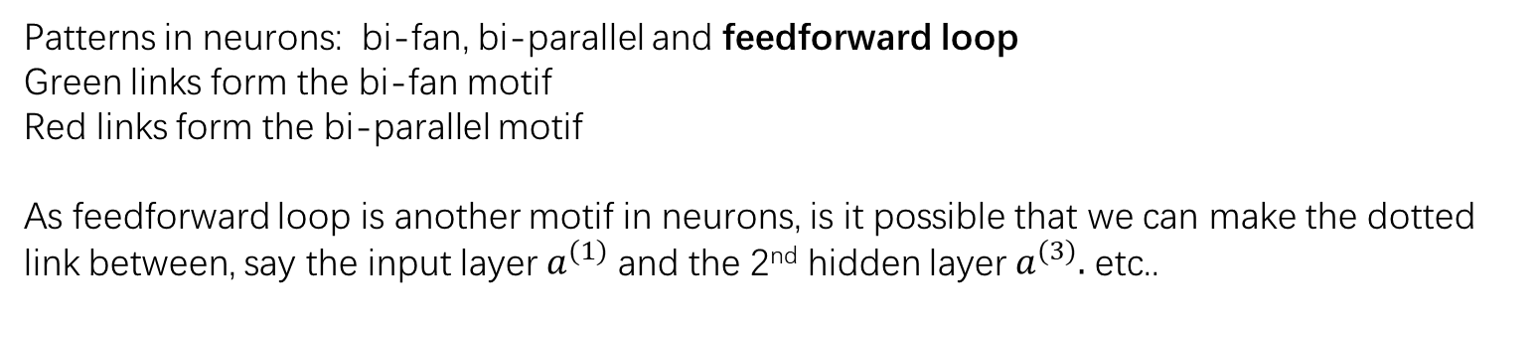
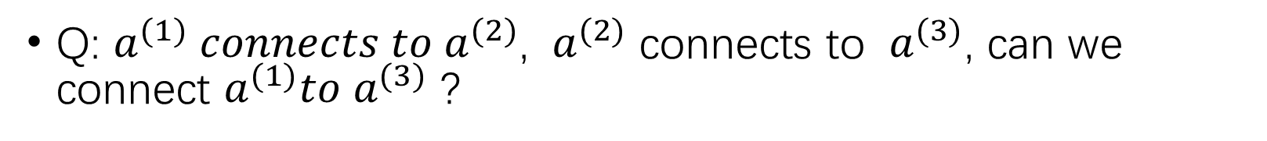
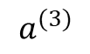
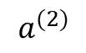
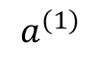
Q: $a^{(1)} connects to{ a}^{(2)}$, ${ a}^{(2)}$ connects to ${ a}^{(3)}$, can we connect $a^{(1)}to{ a}^{(3)}$ ?
$$a^{(1)}$$
$$a^{(2)}$$
$$a^{(3)}$$
Patterns in neurons: bi-fan, bi-parallel and feedforward loop
Green links form the bi-fan motif
Red links form the bi-parallel motif
As feedforward loop is another motif in neurons, is it possible that we can make the dotted link between, say the input layer $a^{(1)}$ and the 2nd hidden layer $a^{(3)}.$ etc..

Slide 9
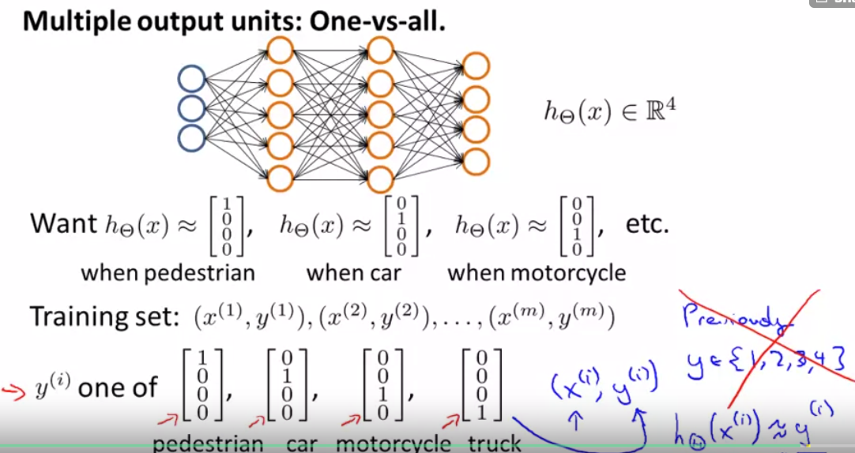
Multiclass Classification
one-hot vector for each class

Slide 10
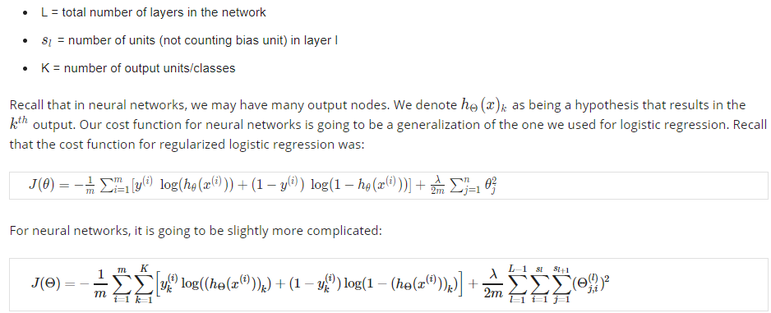
Cost Function
Double sum adds up the logistic regression costs calculated for each cell in the output layer
Triple sum adds up the squares of all θs in the entire network.

Slide 11
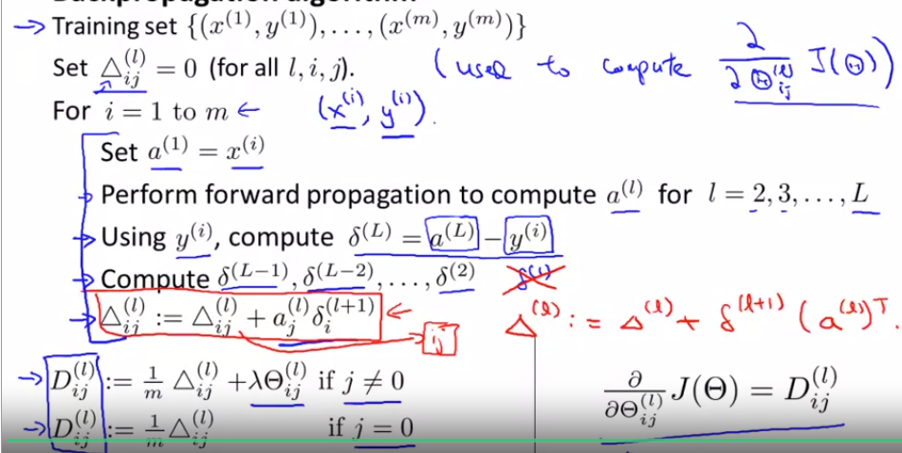
Backpropagation

Slide 12
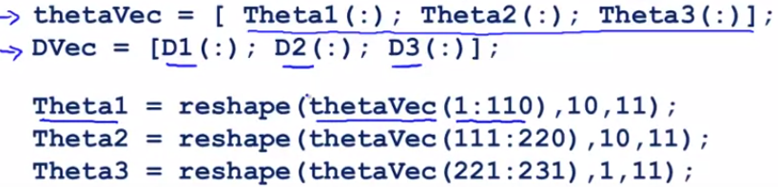
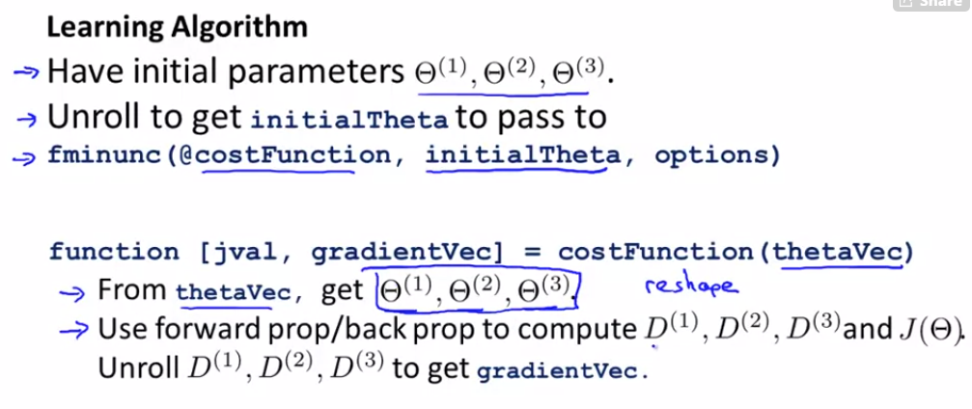
Implementation: Unrolling parameters

Slide 13
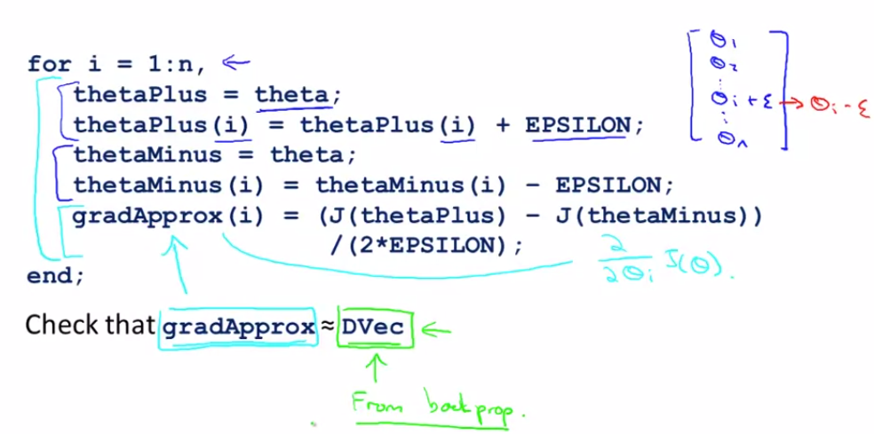
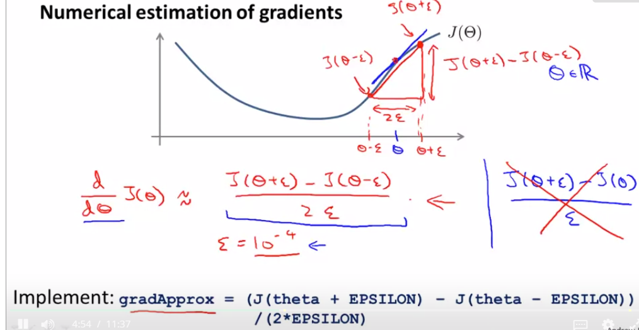
Gradient Checking

Slide 14
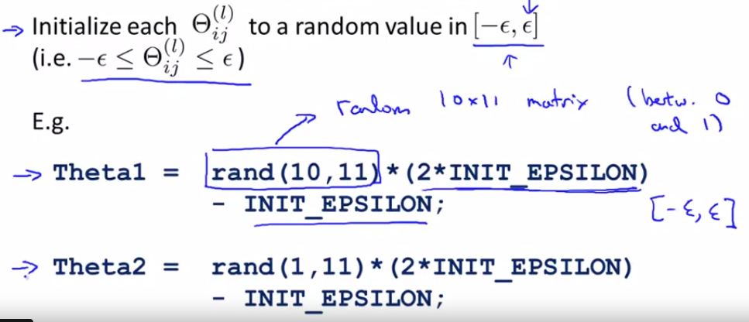
Random Initialization
NOT initialize theta by same value

Slide 15
Machine Learning Diagnostic

Slide 16
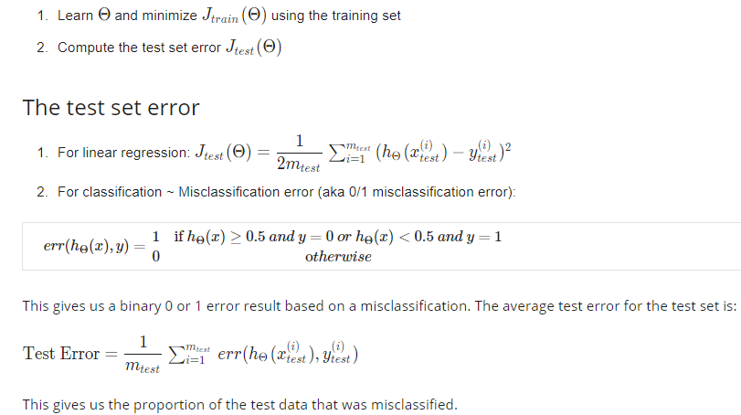

Slide 17
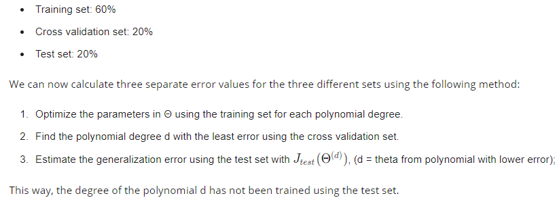
Train/ Validation/ Test Sets
Using validation set to choose hyperparameters (Model selection), such as the degree of polynomial, the number of hidden units, etc

Slide 18
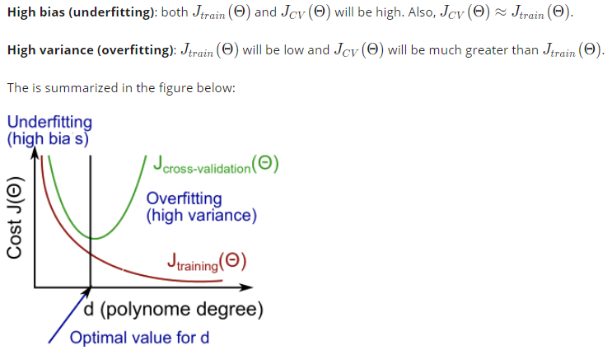
Bias vs. Variance

Slide 19
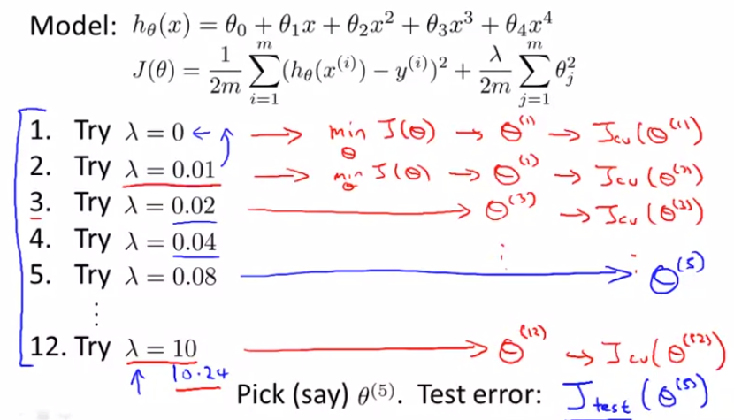
Choosing regularization parameter

Slide 20
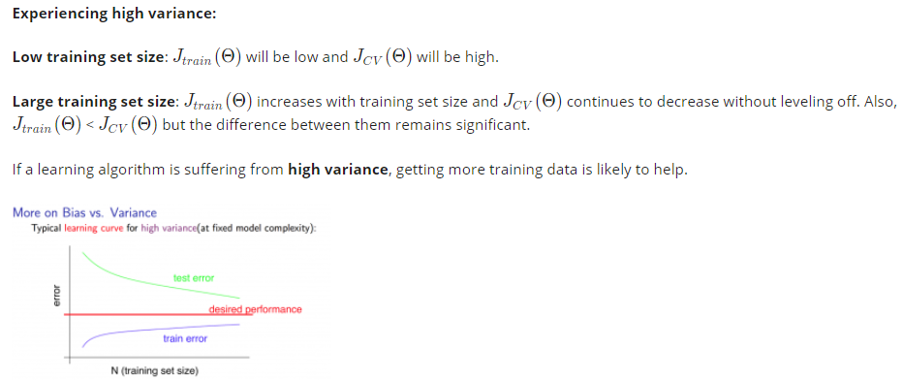
Learning Curve (error – training set size)

Slide 21
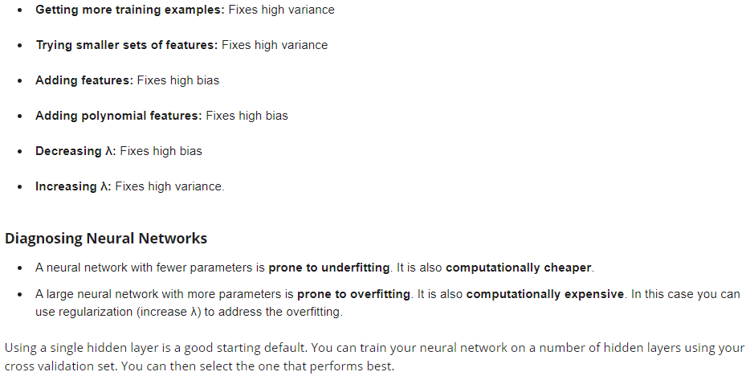

Slide 22
Ex5 Notes
Optional 3.4
Note that set lamba = 0 when test learned model.
because lambda is introduced to deal with overfitting and train parameters of the model.
Optional 3.5 (should be all example from validation set)
for i = 1:m
for t = 1:50
k = randperm(length(X));
[theta] = trainLinearReg(X(k(1:i), :), y(k(1:i)), lambda);
error_train(i) = error_train(i) + linearRegCostFunction(X(k(1:i), :), y(k(1:i)), theta, 0);
error_val(i) = error_val(i) + linearRegCostFunction(Xval, yval, theta, 0);
end
error_train(i) = error_train(i) / 50;
error_val(i) = error_val(i) / 50;
end

Slide 23
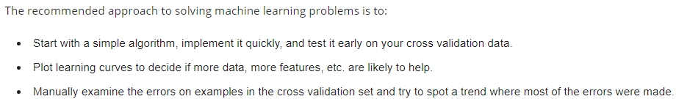
Machine Learning Design
Also, use a single numerical value to evaluate the performance of algorithm, so we can quickly try out different strategies.

Slide 24
